Slide 1

Marketing Statistical Data Jan-Dec 2025

Slide 2
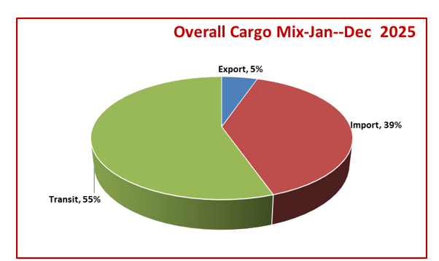
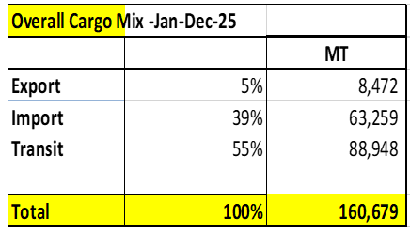
Tonnage ( Jan – Dec 2025)

Slide 3
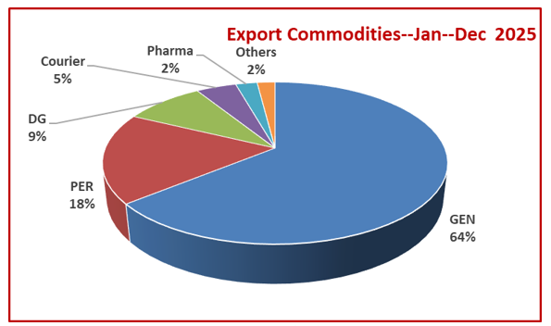
Export Commodities Jan- Dec 2025

Slide 4
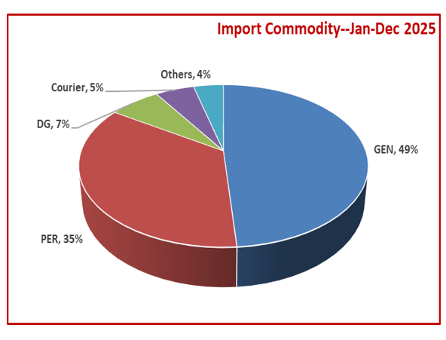
Import Commodities Jan- Dec 2025

Slide 5
Thank you.

